Slide 1





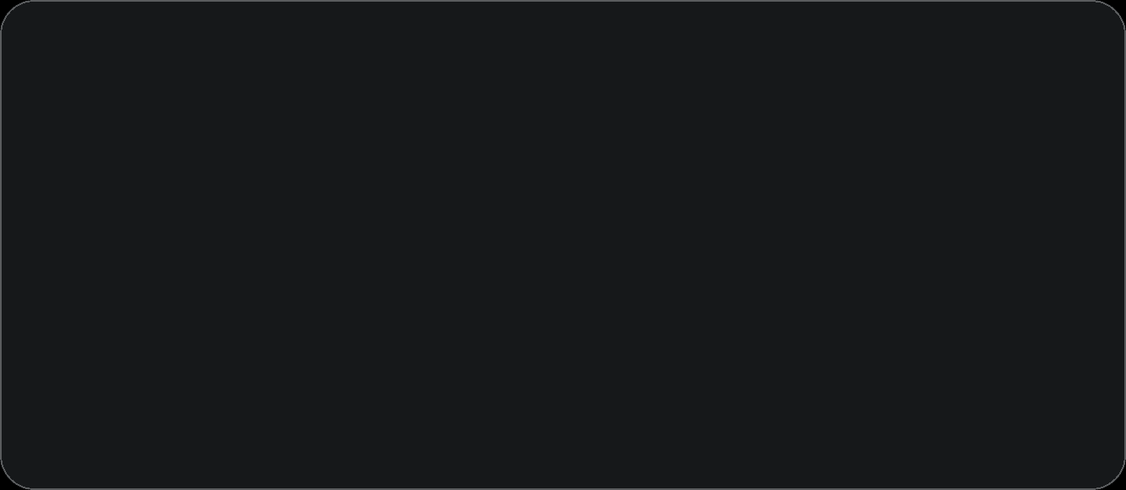

OSCP: One-Step Real-Time Defense
Rongqing Lu
Cong Yuan
Light: Poker King

Slide 2



CONTENTS
01
02
03
Opening & Challenge
Baseline & Architecture
Innovations
04
05
06
Results
Impact & Strategy
Close & Q&A

Slide 3

01
Opening & Challenge

Slide 4


OSCP: One-Step Purification
Ultra-Fast Adversarial Sample Purification System
Light Team [Poker King]
Members: Lu Rongqing | Yuan Cong

Slide 5
The Core Challenge: Speed vs. Robustness
A classic dilemma where traditional defenses are too slow for real-time use.
VS
Traditional DiffPure
OSCP Goal
Strong robustness but extremely slow, making it unsuitable for real-time applications.
Achieve high robustness while maintaining ultra-fast speed for practical, real-time deployment.
Speed: ~500 ms
Speed Target: < 100 ms
Robustness: 60-70%
Robustness Target: Highly Competitive

Slide 6
02
Baseline & Architecture

Slide 7
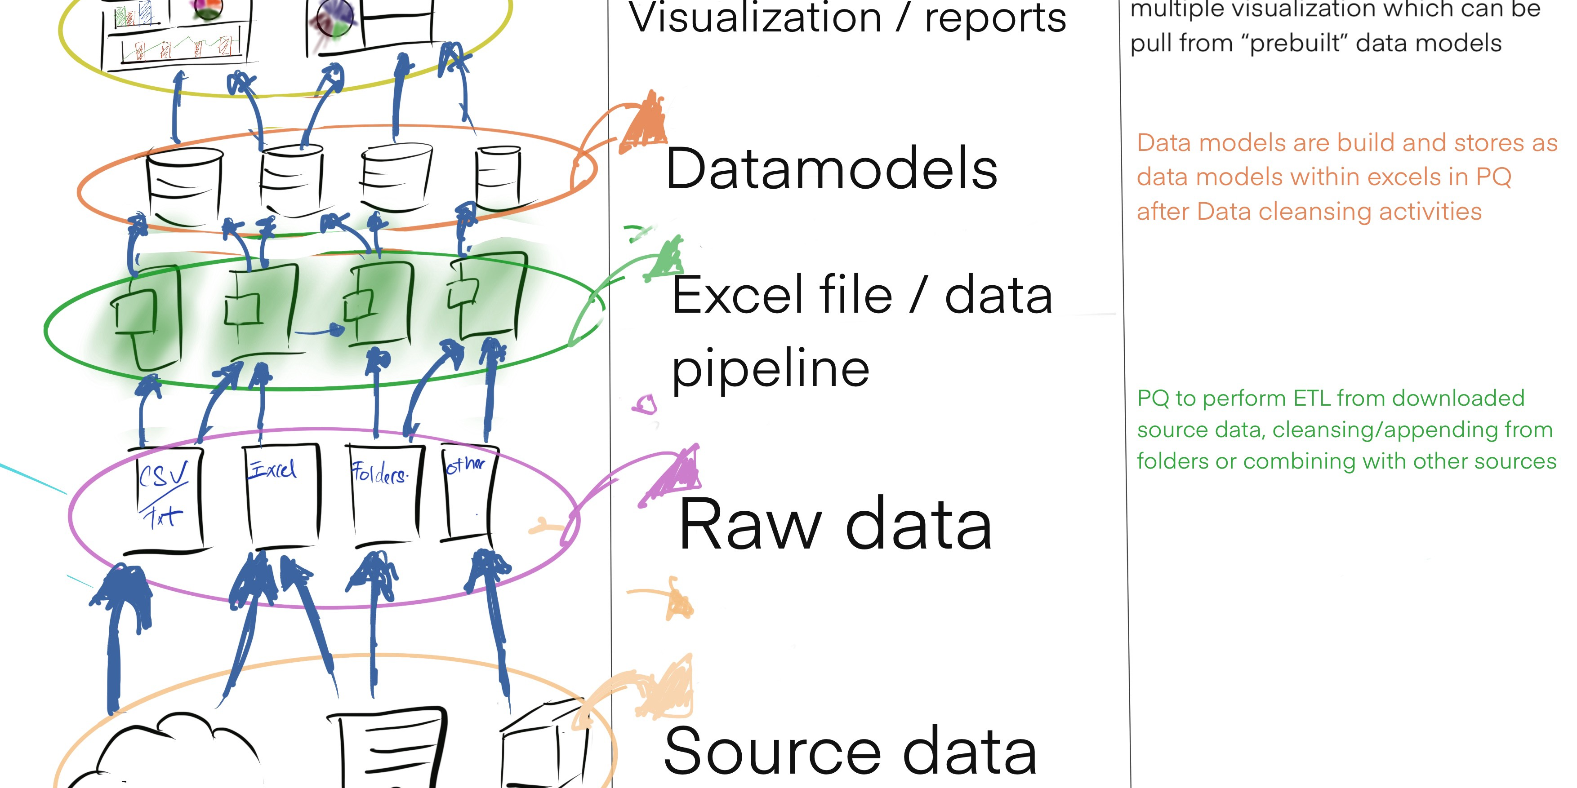
One-Step Distillation Baseline
Our starting point: compressing multi-step diffusion into a single forward pass.
Exceptional Speed & Efficiency
Inference in just 2 ms with only 0.19M parameters.
The Core Challenge
Defense Success Rate was only 37.5%, which is insufficient for real-world threats.

Slide 8
03
Innovations

Slide 9
Dual Upgrade: Capacity & Noise Boost
Two orthogonal improvements to overcome the 37.5% robustness ceiling.
1. Network Capacity Enhancement
2. Adaptive Purification Strength
Increased the core feature dimension (hidden_dim) to provide higher capacity to learn and remove complex adversarial patterns.
Scaled the adaptive noise control factor to strengthen the purification signal against high-intensity adversarial samples.
hidden_dim: 64 → 128
Noise Scale: 1.0× → 1.3×
Parameters: 0.19M → 0.67M
Result: Stronger Defense Signal

Slide 10
04
Results

Slide 11
Final Results: A 25% Leap in Robustness
Our optimization successfully resolved the speed vs. robustness conflict.
Unoptimized Baseline
Optimized Final
Defense Rate: 37.5%
Defense Rate: 46.9%
Speed: 2 ms
Speed: 4.46 ms
Minimal Trade-off
Accuracy: 78.0%
Speed only creeps to 4.46ms
Accuracy: 80.3%
The gain in robustness dwarfs the minimal slowdown, and we remain 20× faster than our 100ms target.

Slide 12
05
Impact & Strategy

Slide 13
Peer Targeting: A Defense Against PIAA
Our strategy focused on resisting the strongest anticipated attack: Purification Evasion.
Real-Time Defense
46.9% Defense @ 4.46ms
Our Defense
PIAA Attack
Enhanced Capacity & Noise
Purification Evasion
This achievement proves OSCP offers the best speed-robustness trade-off for real-time adversarial defense.

Slide 14
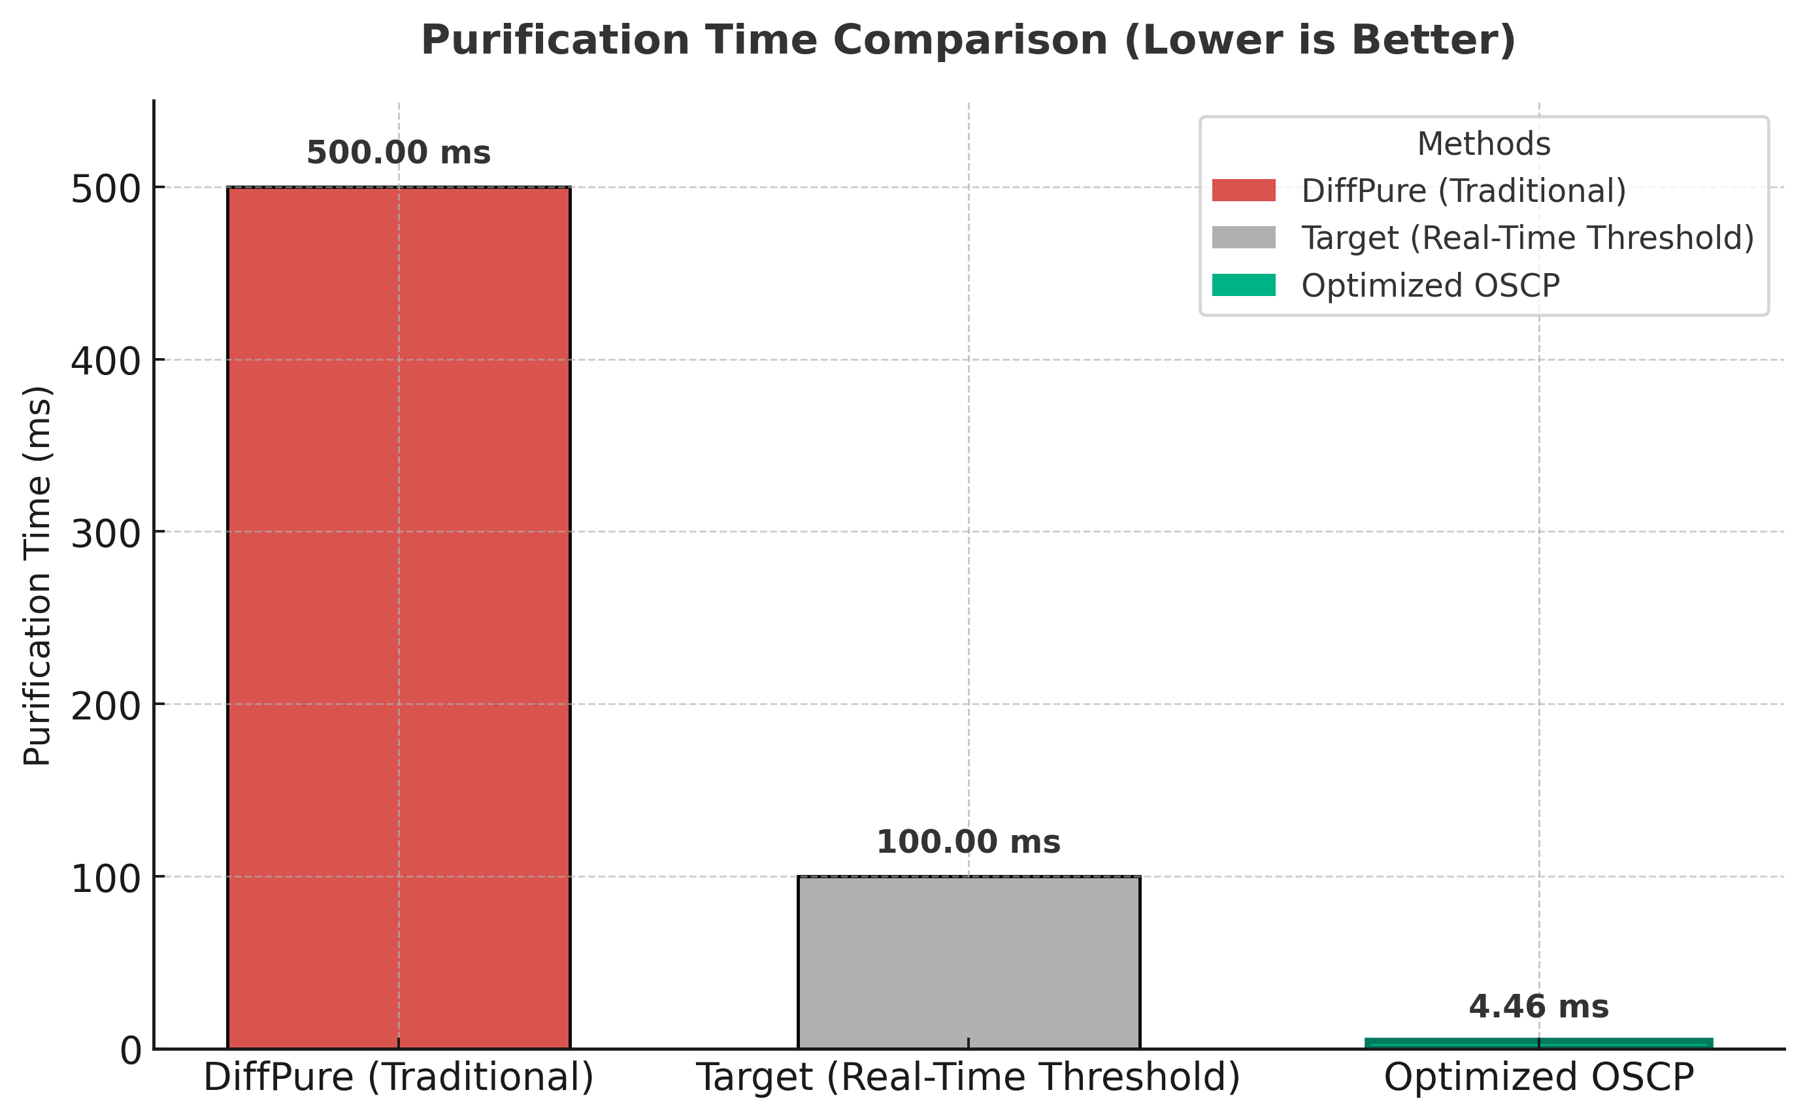
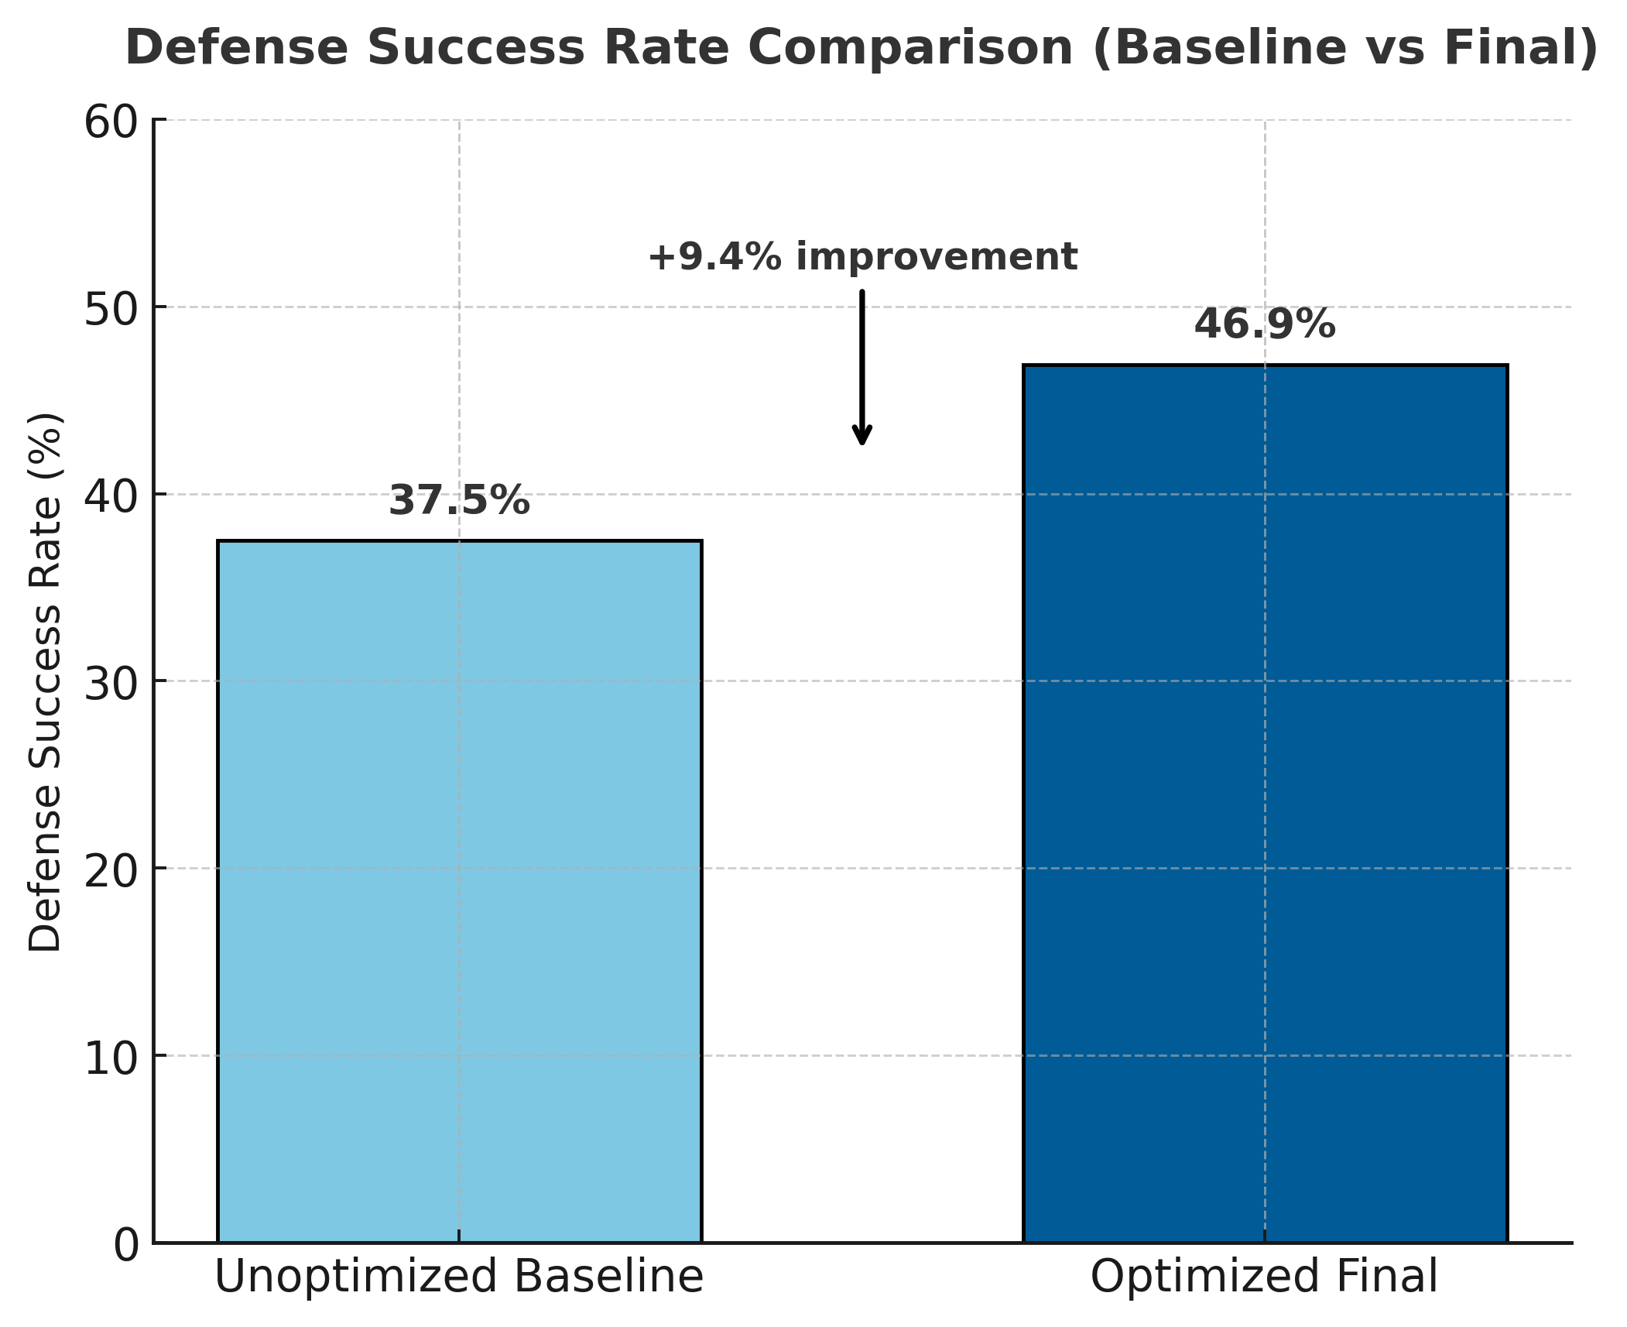
Speed Comparison
Robustness Improvement

Slide 15
06
Close & Q&A

Slide 16
Conclusion & Future Work
Core Achievement
Future Work
We implemented the first one-step purifier to break 45% defense in under 5 ms.
Training Data Scaling
Increase training data from 100 to 200+ batches.
Team Contribution
Purification Strategy
Explore more aggressive parameters and stronger adversarial training (e.g., PGD-10).
Lu Rongqing: Core architecture, capacity optimization, testing.
Yuan Cong: Noise control, PIAA sample generation, documentation.
Thank you! We welcome any questions.

Slide 17
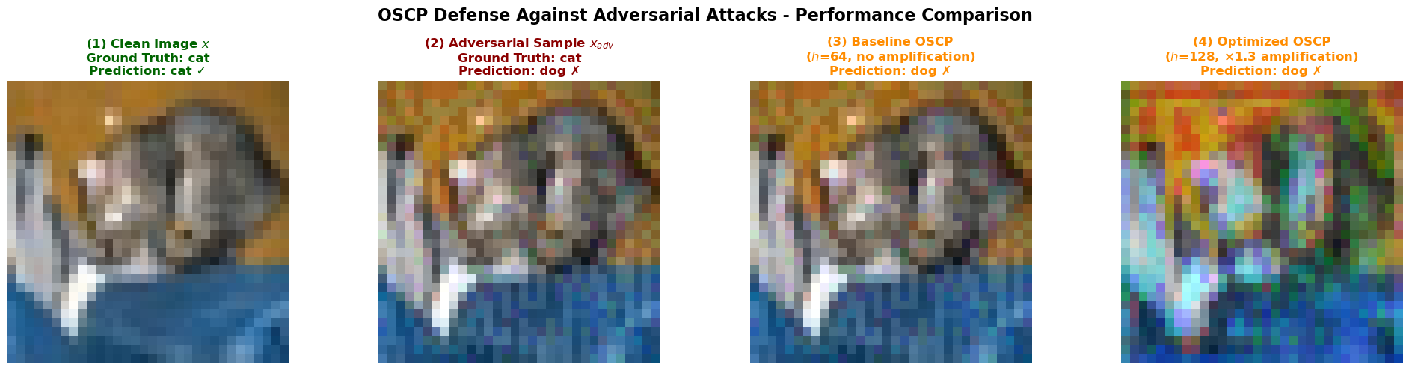
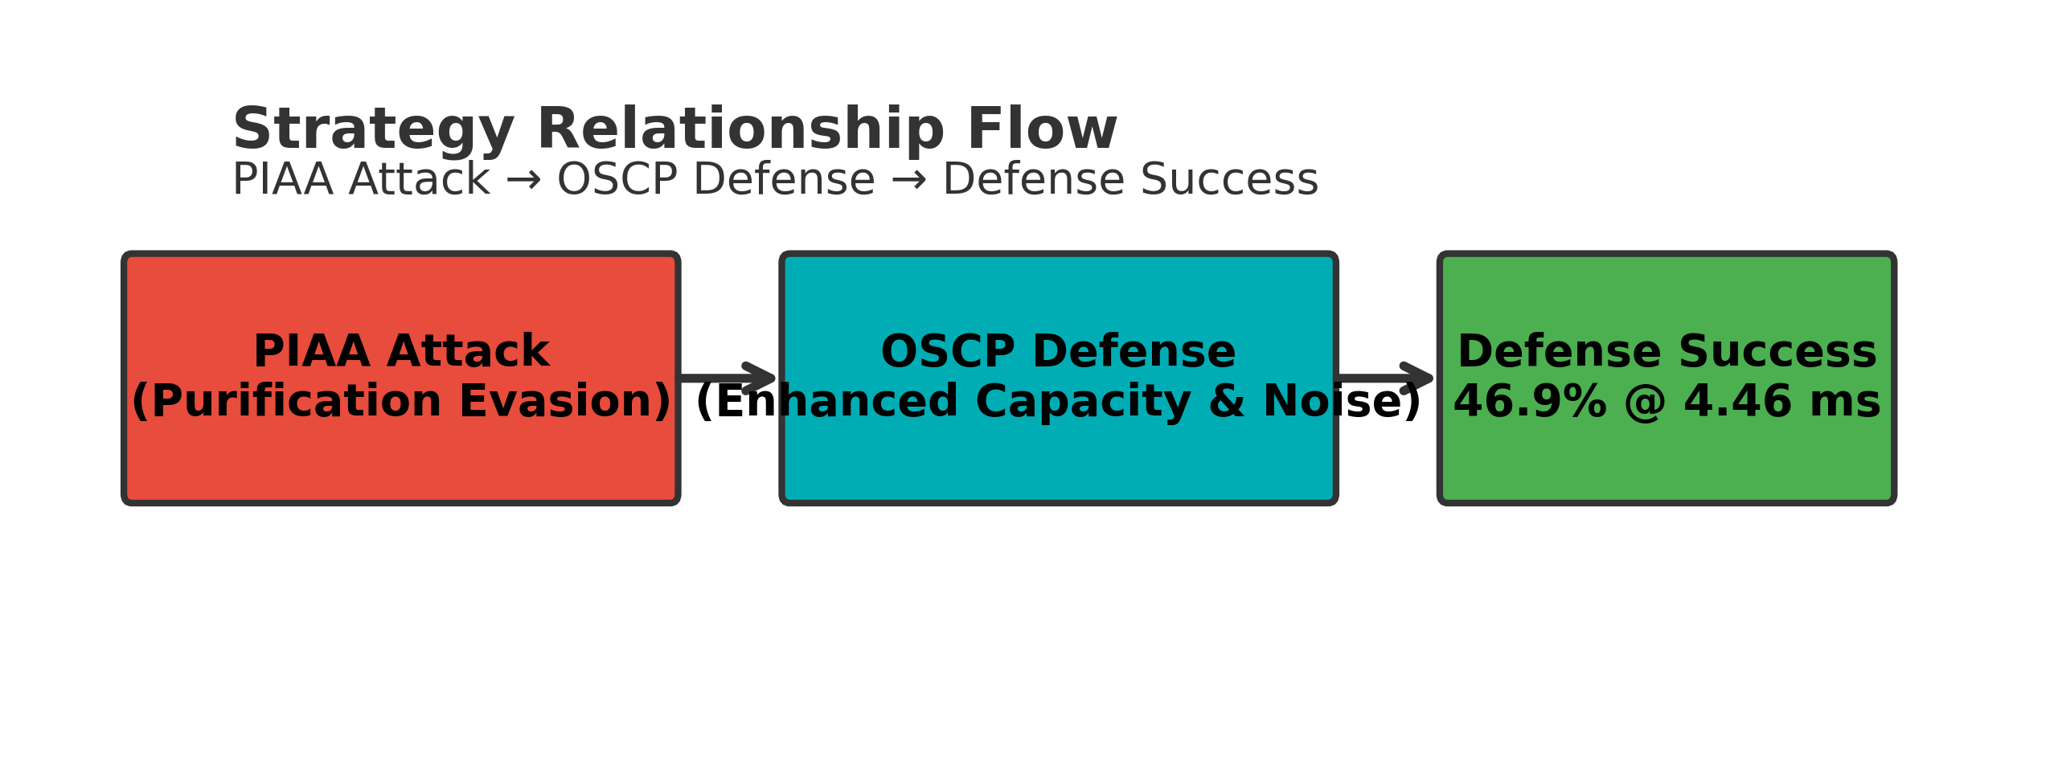
Final Results

Slide 18



THANK YOU
Rongqing Lu
Cong Yuan
Light: Poker King

